Slide 1
CS/IT BSc Projects
Ubiquitous Computing and Interaction

Slide 2
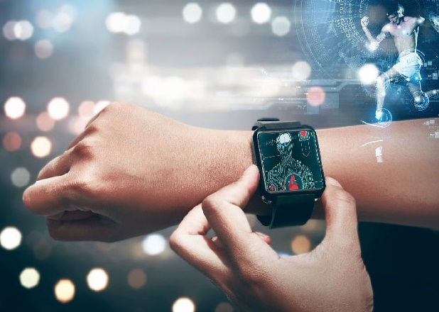
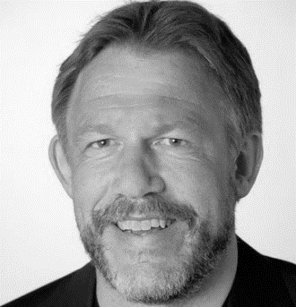
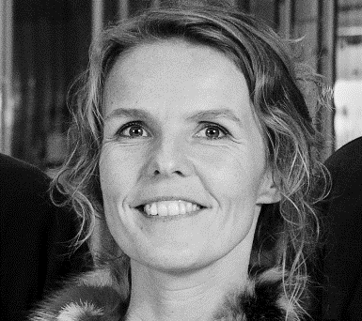
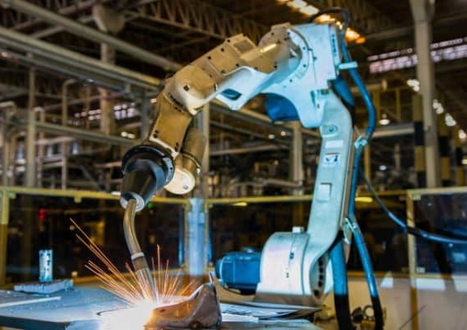
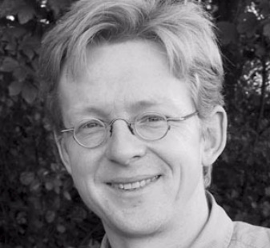
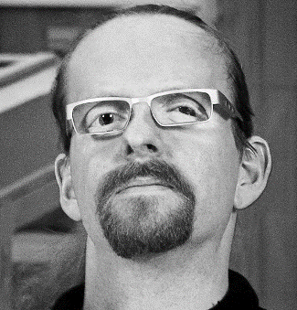

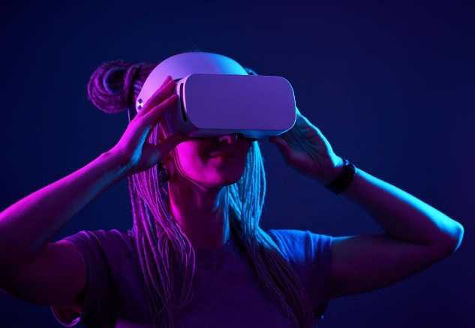
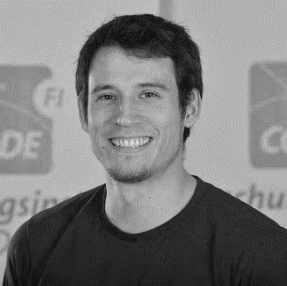
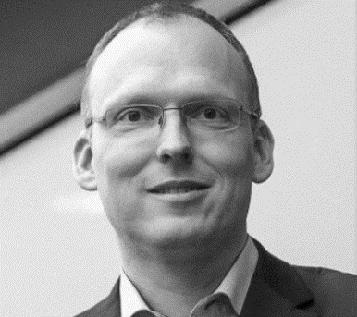

KAJ
MARIANNE
HANS
NIELS OLOF
KEN
HANS-JÖRG

Slide 3
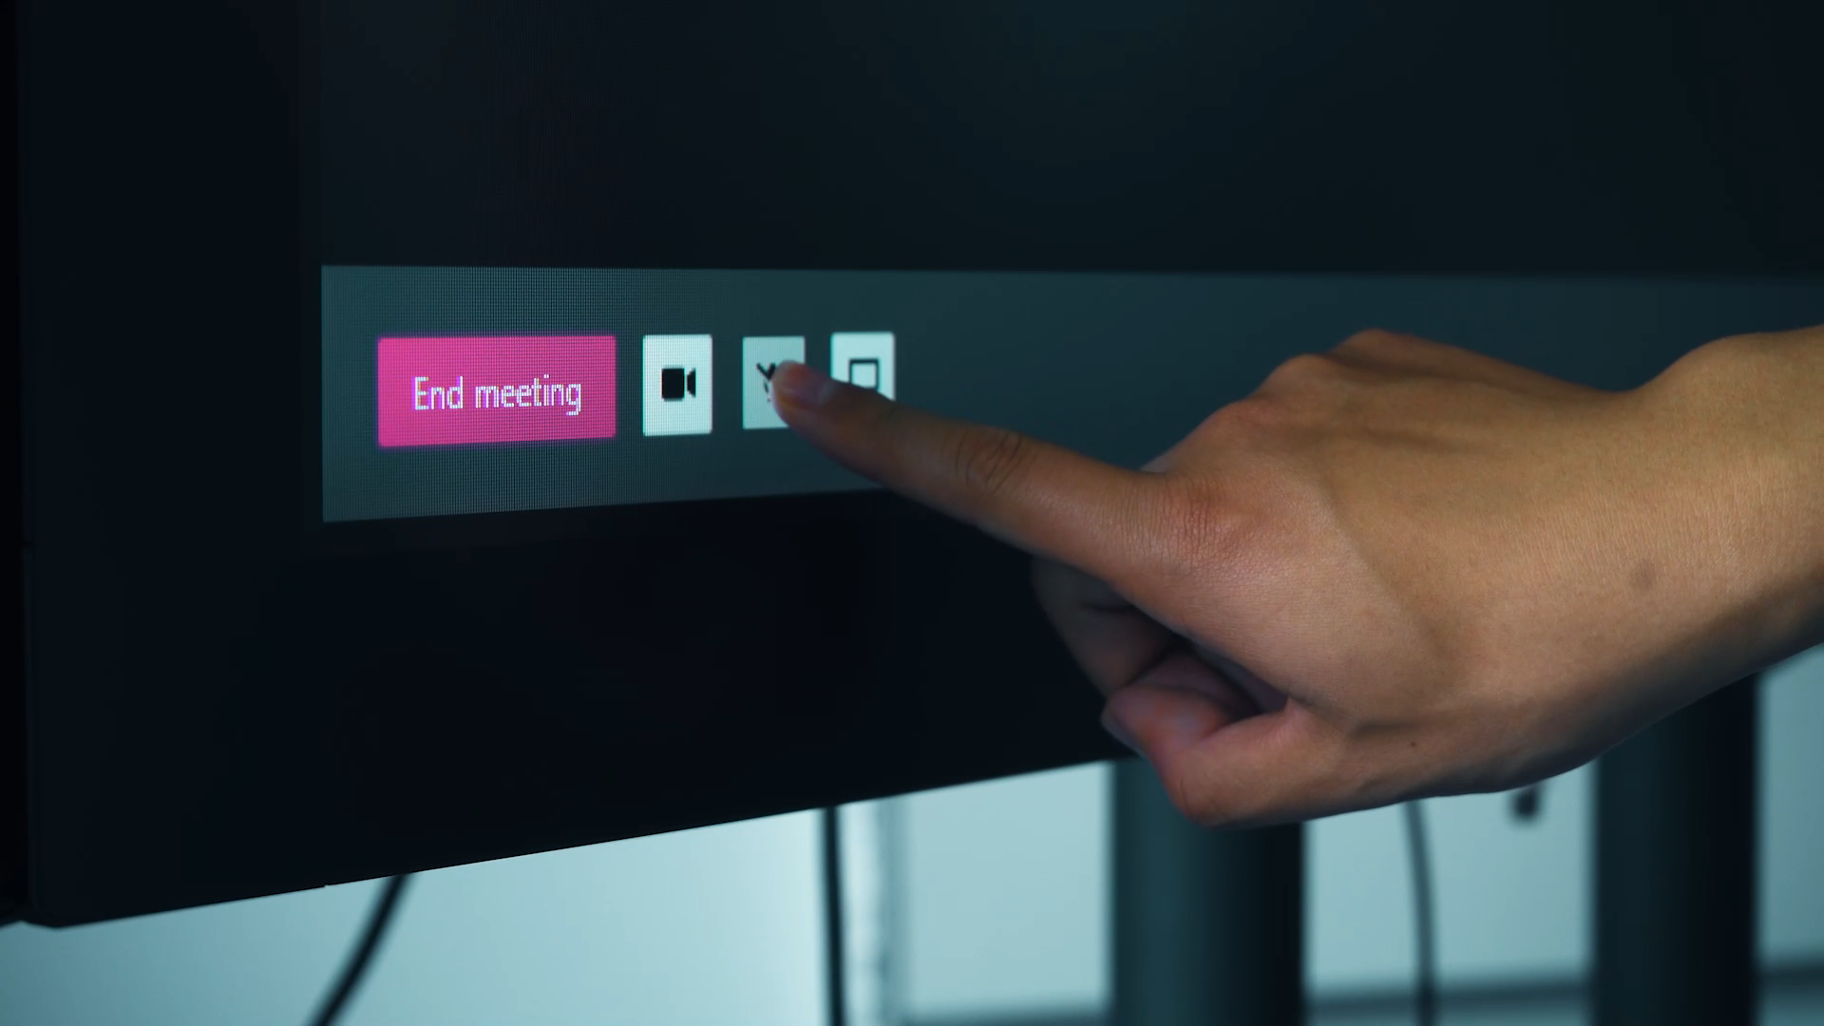
[UBI-A] Communication Cues for Video Conferencing Systems

Slide 4
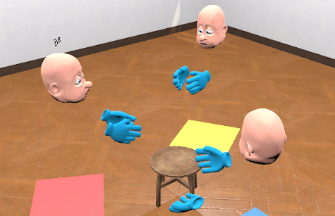
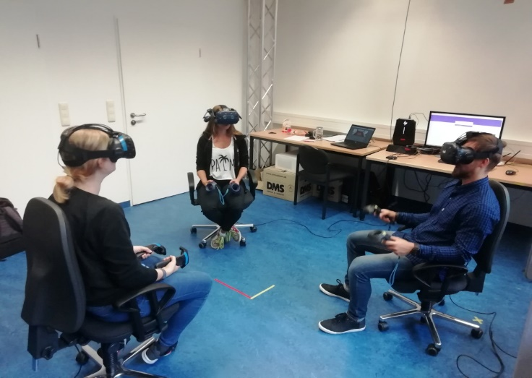
[UBI-B] Multimodality in VR Collaboration
Making virtual conver-sations more natural through non-verbal cues
Eye Movement
Hand Movement
Body / Stance / Gait
Face & Mouth Expressions
Unity + Vive Pro or Oculus Quest 2

Slide 5
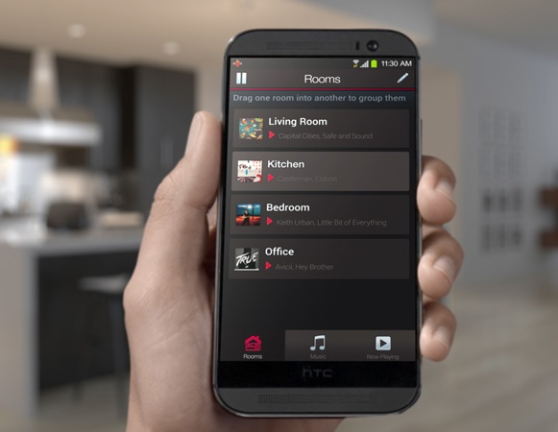
[UBI-M] Seamless Music Streaming
Transitions
Room to Room
Phone to Stereo
Playlist A to Playlist B
Sensors for spatial, temporal, and social context

Slide 6
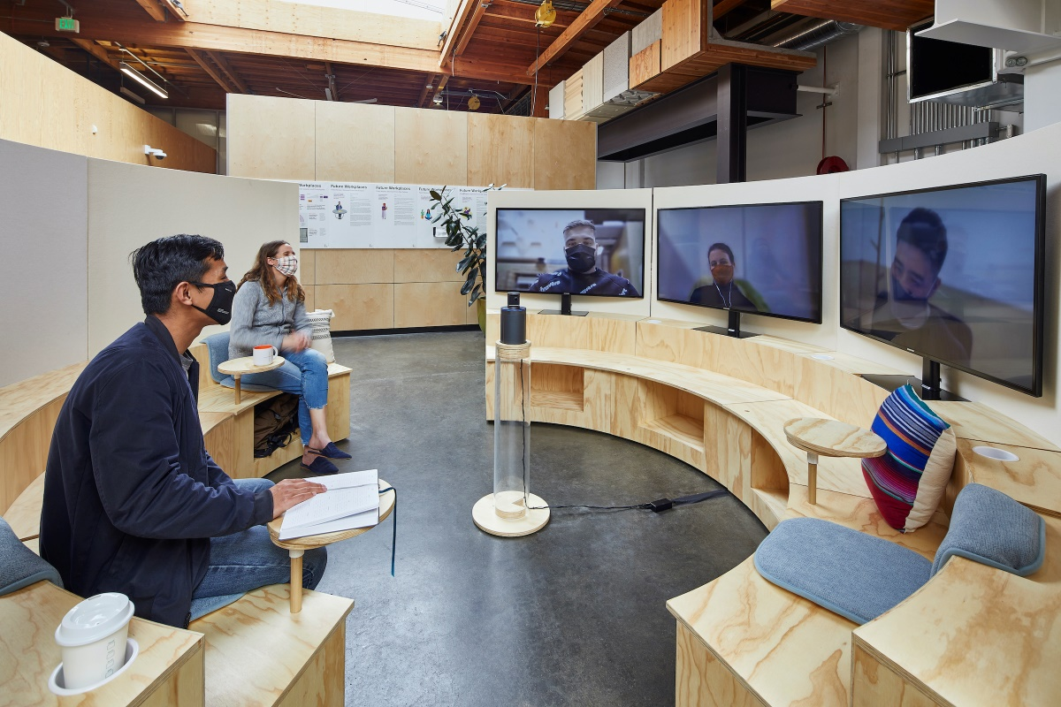
[UBI-N] Designing to support Hybrid collaborative work
Interaction Techniques & Interactive Interiors for
mixed meetings
shifting collaborations
Challenge: establishing symmetry between co-present and remote workers to engage in the collaboration

Slide 7
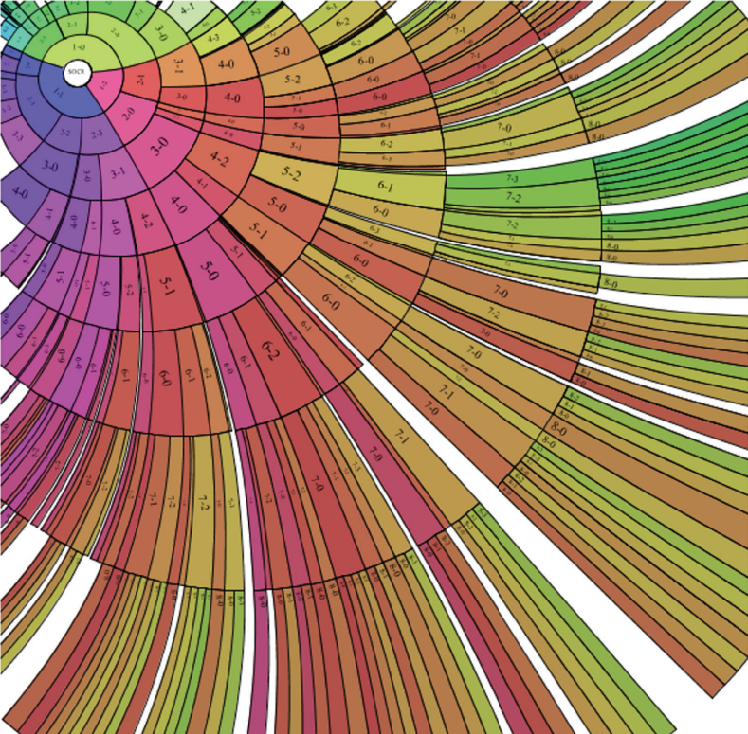
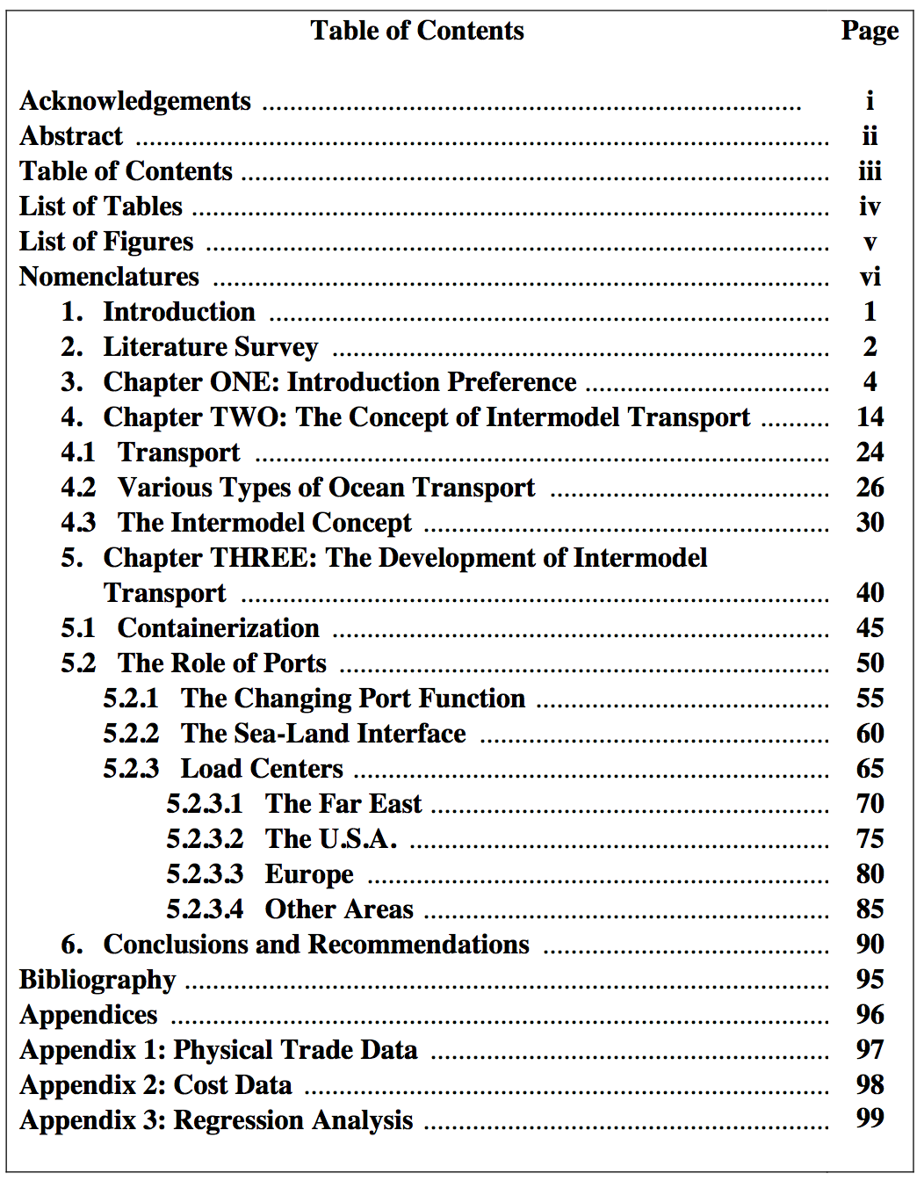
[UBI-L] Reinventing Books’ Table of Contents in a visual-interactive form
Bring the TOC into the 21st century!
Visual / Graphical
Interactive
Reactive
Beautiful

Slide 8
UBI BSc Projects
If you want to know more come to the information meeting right after or drop me an email at hjschulz@cs.au.dk.

